Slide 1
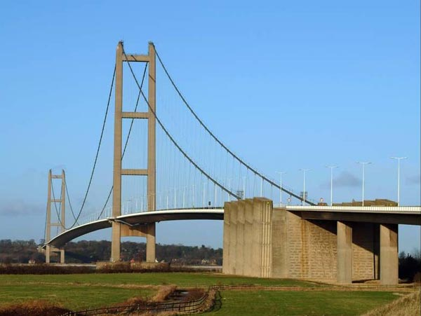
FOUNDATION OF
BRIDGE ON
BLACK COTTON / Clay SOIL

Slide 2

  A
  Project Report
  on
  GUIDED BY : DEVELOPED :
  MR. J. K. PRAJAPATI PATEL SINGER C.
  PRAJAPATI KALPESH R.
  SATHVARA SAHIL B.
  SHAH CHINTAN M.
  TRIVEDI PRIYANK M.
D.E 6th SEMESTER
Nov/Dec, 2011
FOUNDATION OF BRIDGE
ON BLACK COTTON SOIL
CIVIL ENGINEERING

Slide 3
S.D PATEL POLYTECHNIC,GADHA
MEHSANA -384002
CERTIFICATE
TO WHOM SO EVER IT MAY CONCERN
This is to certify that Mr. Patel Singer , Prajapati Kalpesh , Sathvara Sahil , Shah Chintan , Trivedi Priyank Student of D.E. Semester 6th (Civil Engineering) has completed his one full semester project work titled “Foundation Of Bridge On Black Cotton Soil” satisfactorily in partial fulfillment of requirement of Diploma of Civil Engineering of Gujarat Technology University, in the year 2012.
MR. R.D.PATEL MR. V.V.PATEL
H.O.D. (CIVIL)
S.D.P,GADHA

Slide 4
Construction of minor bridge
Site Name :- Construction of minor bridge
At- parab ,
To -haldhru road
Ta. Kamraj,dist-surat.
Company :- Akshay Construction,Surat

Slide 5
Construction of minor bridge
Parts of bridge :
Foundation
Pier
Abutment
Abutment and Pier cap
Slab
Wearing coat

Slide 6
Type of soil :
Black cotton soil
Nature of Black cotton Soil :
BC soils absorb water heavily, swell, become soft, loose strength, easily and has at tendency to heave during wet condition.
BC soils shrink in volume and develop cracks during summer. They are by extreme hardness and cracks when dry.
Soils are called highly expansive when free swell index exceeds 50 undergo volumetric changes leading to pavement distortion, cracking unevenness due to seasonal wetting and drying.
BC soils produce a CBR value of 2 to 5% if compacted efficiently.

Slide 7
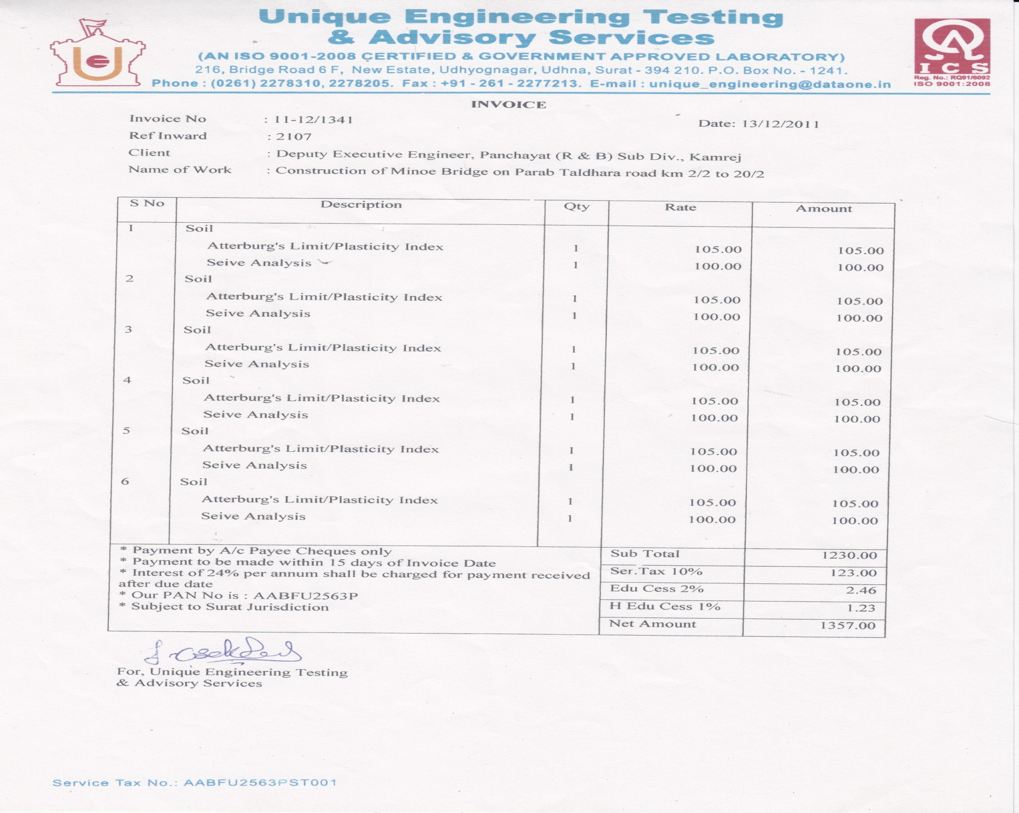
a soil testing report

Slide 8
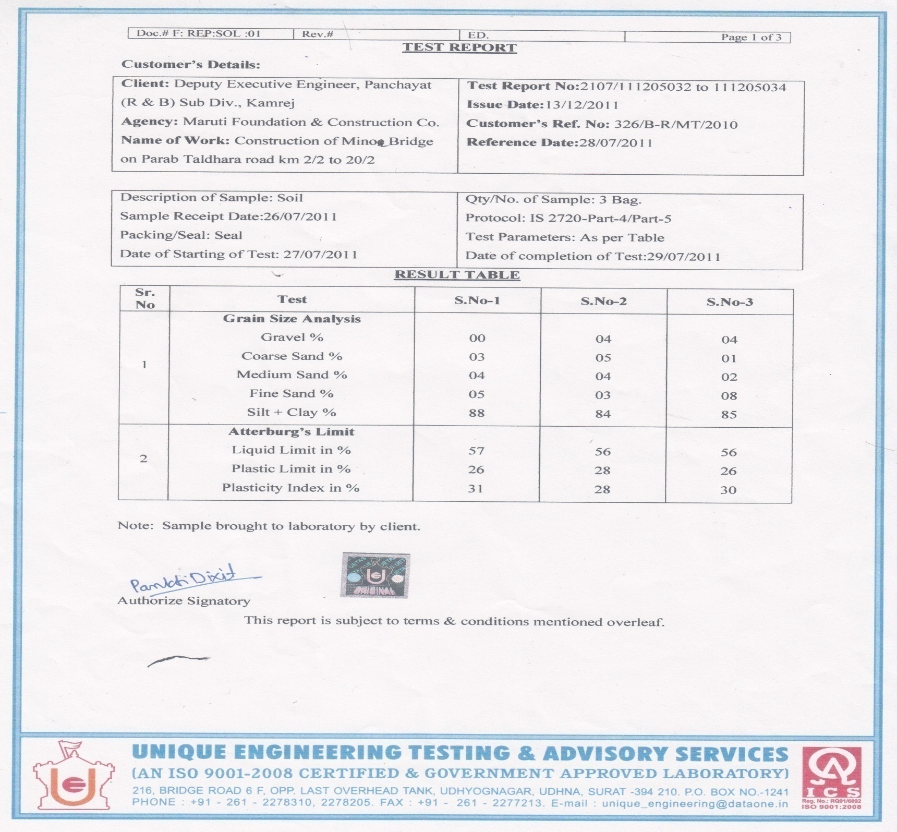

Slide 9
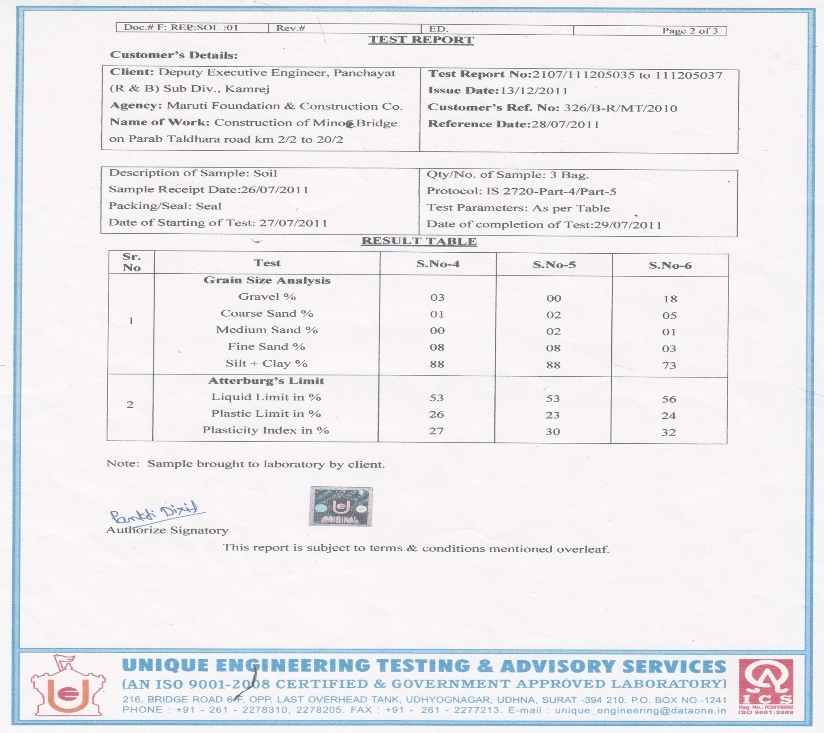

Slide 10
Description
Foundation :
The foundation is the main part of any construction. The stability or the strength of the structure depend on foundation.
There are different types of foundations for the different types of soils. Types of foundations used are as under.
Pile foundation
deep foundation
mat foundation
caisson foundation
shallow foundation

Slide 11
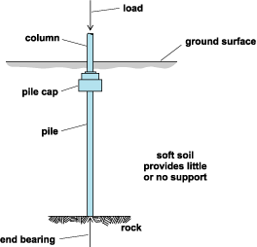
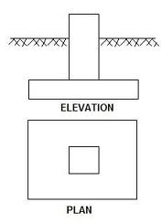
Pile foundation
Shallow foundation

Slide 12
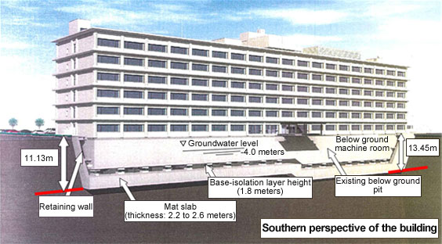
Mat foundation

Slide 13
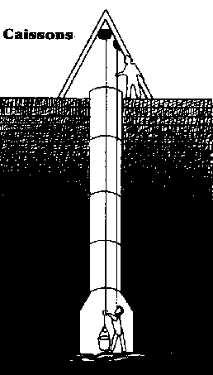
Cassion foundation

Slide 14
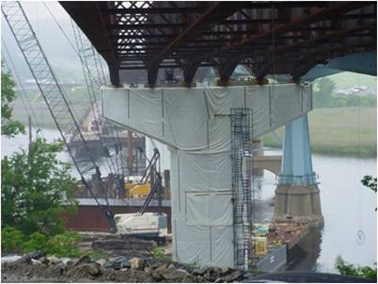
Following are the advantages of composite bridges.
It leads to reduction in deflection and vibrations.
It leads to speed in construction.
It proves to be economical.
It results in better quality control.
The cost of formwork is reduced.
The cost of foundations for abutments is reduced.
The cost of transportation is minimized.
The overall depth of beam for a composite construction is reduced and it leads to savings in lengths of approaches.

Slide 15
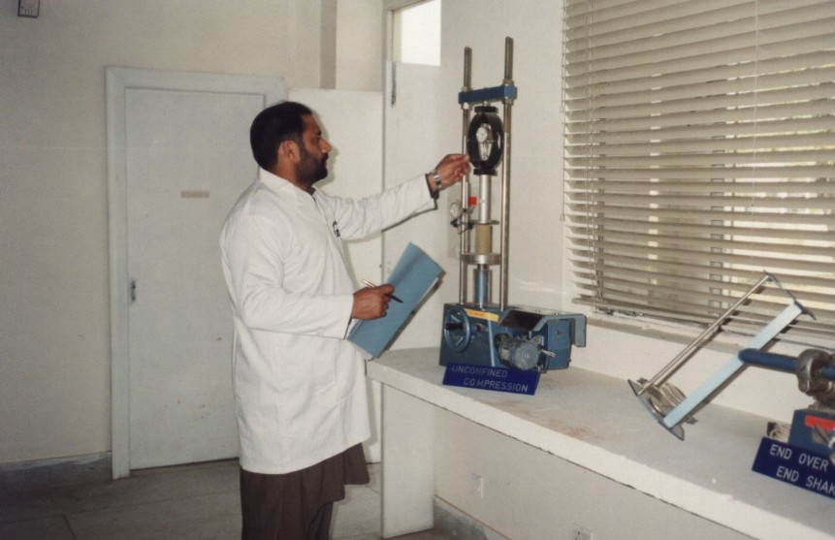
Problem detected in foundation
Probable Mistakes in checking of load bearing capacity of soil:
The design of foundation is depended on load bearing capacity of particular types of soils. If engineer created any mistakes to find out load bearing capacity of soil then automatically wrong foundation design is created. Because of that mistake foundation gone a failure…….
Soil of this site is black cotton soil and load bearing capacity of black cotton soil is less. That’s why open foundation is used here.

Slide 16
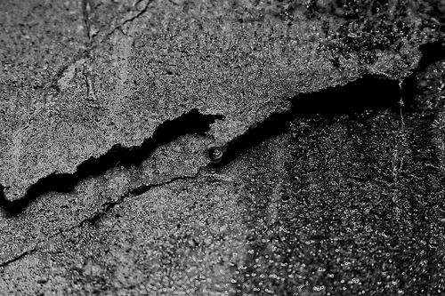
Possibility of Cracks in foundation :
It is possible that some cracks may develop in the foundation of this structure. That cracks may occur by using low quality of concrete or because of not removing the air voids during the placing and consolidating of concrete work.
It may also occur because of not using the vibrator during consolidation of concrete. As the vibrator removes the air voids from the foundation.
The cracks are also occur if curing is not carried out in proper way and in proper time.

Slide 17
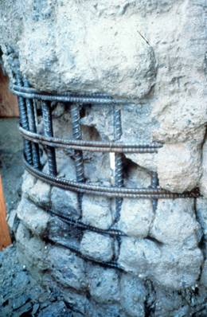
Structural Defect Produced by Interruption in Concreting and Low Slump Concrete

Slide 18
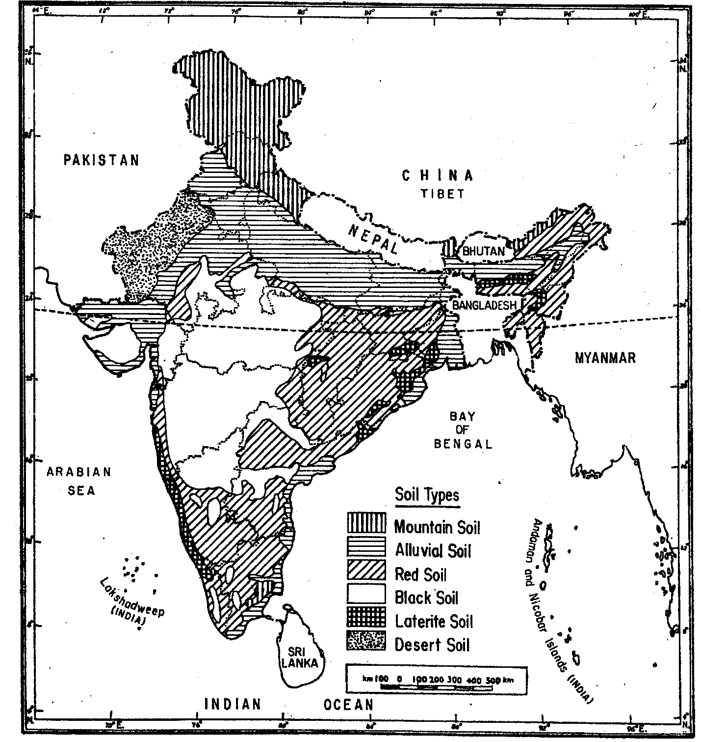
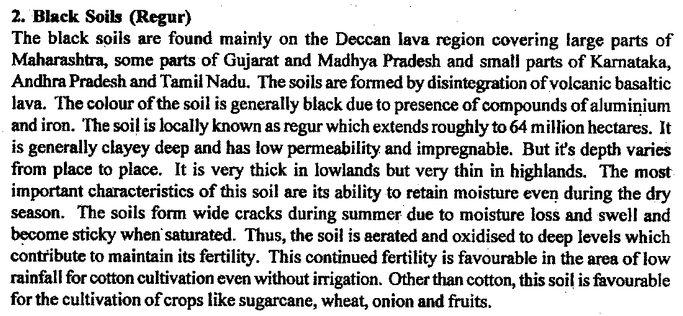

Slide 19
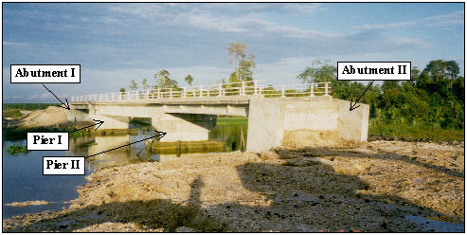
Failure case
CASE HISTORY
Background
Similar to Case History , this project was under construction when failures occurred. This project is also an access road with prestressed concrete bridge over a river in Sarawak. The proposed heights of the approach embankments on both sides of the abutments were about 5m with side slopes of 1v(vertical) to 1.5h(horizontal). These embankments were constructed over 25m thick of soft coastal and riverine alluvium clay followed by dense silty Sand and very stiff silty clay. The soft alluvium generally has SPT N’ value of zero and average moisture content of more than 70%.
.
Overview of partially completed bridge

Slide 20
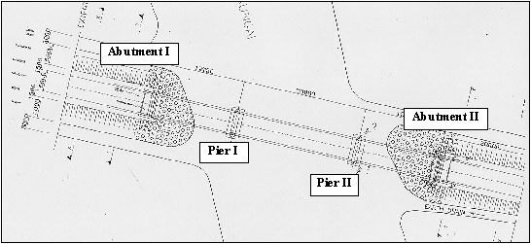
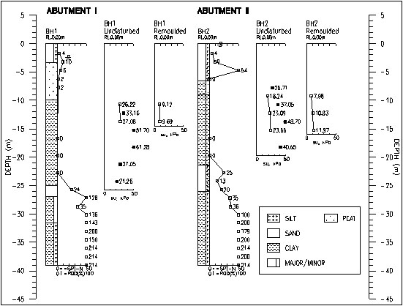
Layout of the Bridge in this Case
Subsoil condition

Slide 21
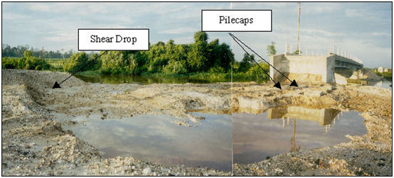
Slip Failures of the Approach Embankments
A deep seated slip failure occurred at the approach embankment about 25m from Abutment II. It happened when the fill reached about 3m high. Fig. shows the shear drop after removal of some of the fill near the abutment.
Shear Drop at about 25m from Tilted Abutment

Slide 22
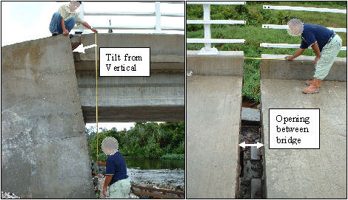
Abutment II has tilted away from the river with the magnitude of about 550mm at the top of the abutment at the time of the site inspection by the Authors who were carrying out geotechnical investigation of the failure. The tilt translates into an angular distortion of 1/6. Due to the excessive angular distortion, the integrity of the pile driven to set into the stiffer stratum has also been affected as it exceeds the normal threshold of about 1/75. Due to the tilt of the Abutment II away from Pier II, a gap of about 300mm wide was observed between the two bridge decks at the pier’s pile cap. Fig shows the photograph of the tilt at the Abutment II and the gap between two bridge decks. The failure also caused the pile cap at Pier II to tilt as shown in Fig the schematic diagram of the possible slip plane relative to the deformed structures.
Tilted Abutment and Observed Gap between Bridge Decks

Slide 23
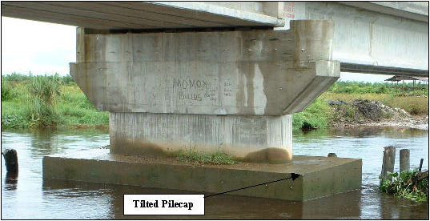
These observations infer that the slip of the Approach Embankment near Abutment II is deep seated and is consistent with the depth of the soft alluvium. The cause of the rotational slip failure is due to the weak subsoil strata viz. unable to support the weight of the approach embankment. The weight of embankment initiated the consolidation settlement of the soft subsoil and mobilized the low shear strength of the slip failure plane. The use of the 6m wood piles and RC piles offers little lateral resistance and instead, extends the rotational slip deeper into the soft subsoil. At the pier, the bridge decks, being simply supported and fixed to the abutment via bearing pad, had moved along with the displacement of the abutment.
Titled pilecap at Pier II

Slide 24
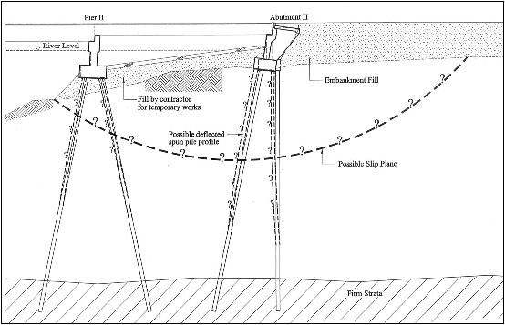
Schematic of the slip failure

Slide 25
Foundation Design Process :
Scope & Field Reconnaissance
Field Explorations & Field Testing
Laboratory Testing
Foundation Design
Foundation Reports
Specifications
Construction Support

Slide 26
Specifications
Piling
Estimated Pile Lengths (steel piles)
Number of Pile Splices
Tip Treatment (open or closed end,
reinforcement)
Driving Criteria
Wave Equation Input (if applicable)
Pile freeze, preboring or jetting allowed
Shafts
Designated Friction or End Bearing
Permanent Casing Requirements
Crosshole Sonic Log (CSL) testing
required

Slide 27
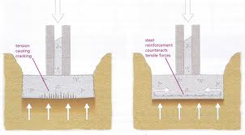
Safety Precautions :
1. To limit the load on
the soil to 5.5
tonnes/ sq.mt.
if water is liable to
to find an access to
the foundations, the
limit of loading should
be restricted to 4.9
tonnes/ sq.mt.

Slide 28
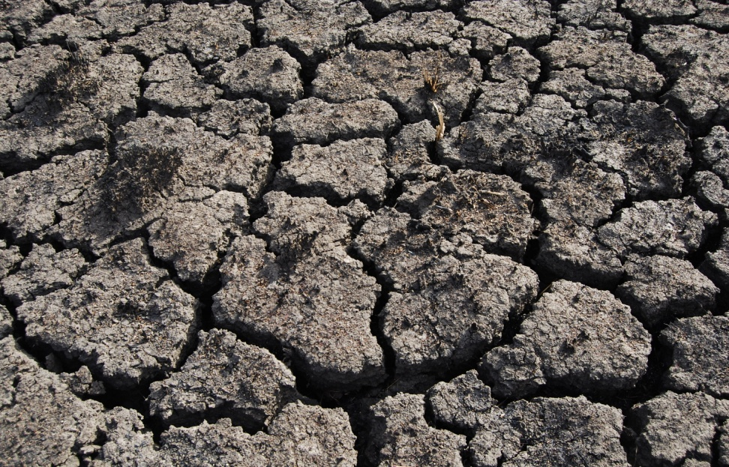
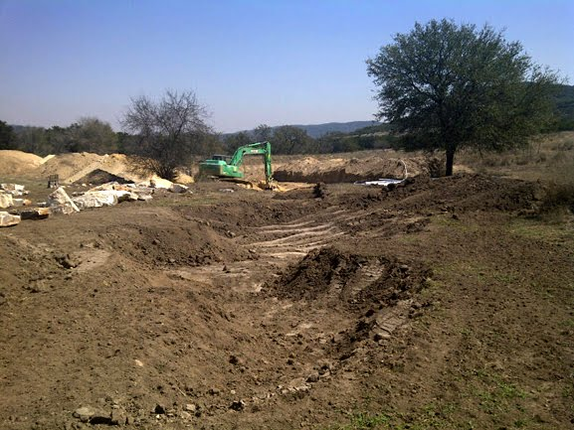
2. To take the foundation to
such depths where the
cracks cease to extend.
The minimum depth of
foundation should be not
Less than 1.5 mt.
3. Construction in black
cotton soil should be
undertaken during
dry season.

Slide 29
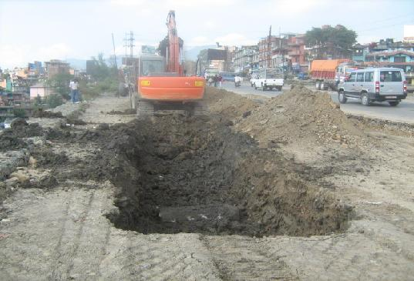
4. If the depth of the black cotton soil at a given site is only 1 to 1.5 m, the entire black cotton soil above the hard bed may be completely removed and the foundation may be laid on the hard bed below.

Slide 30
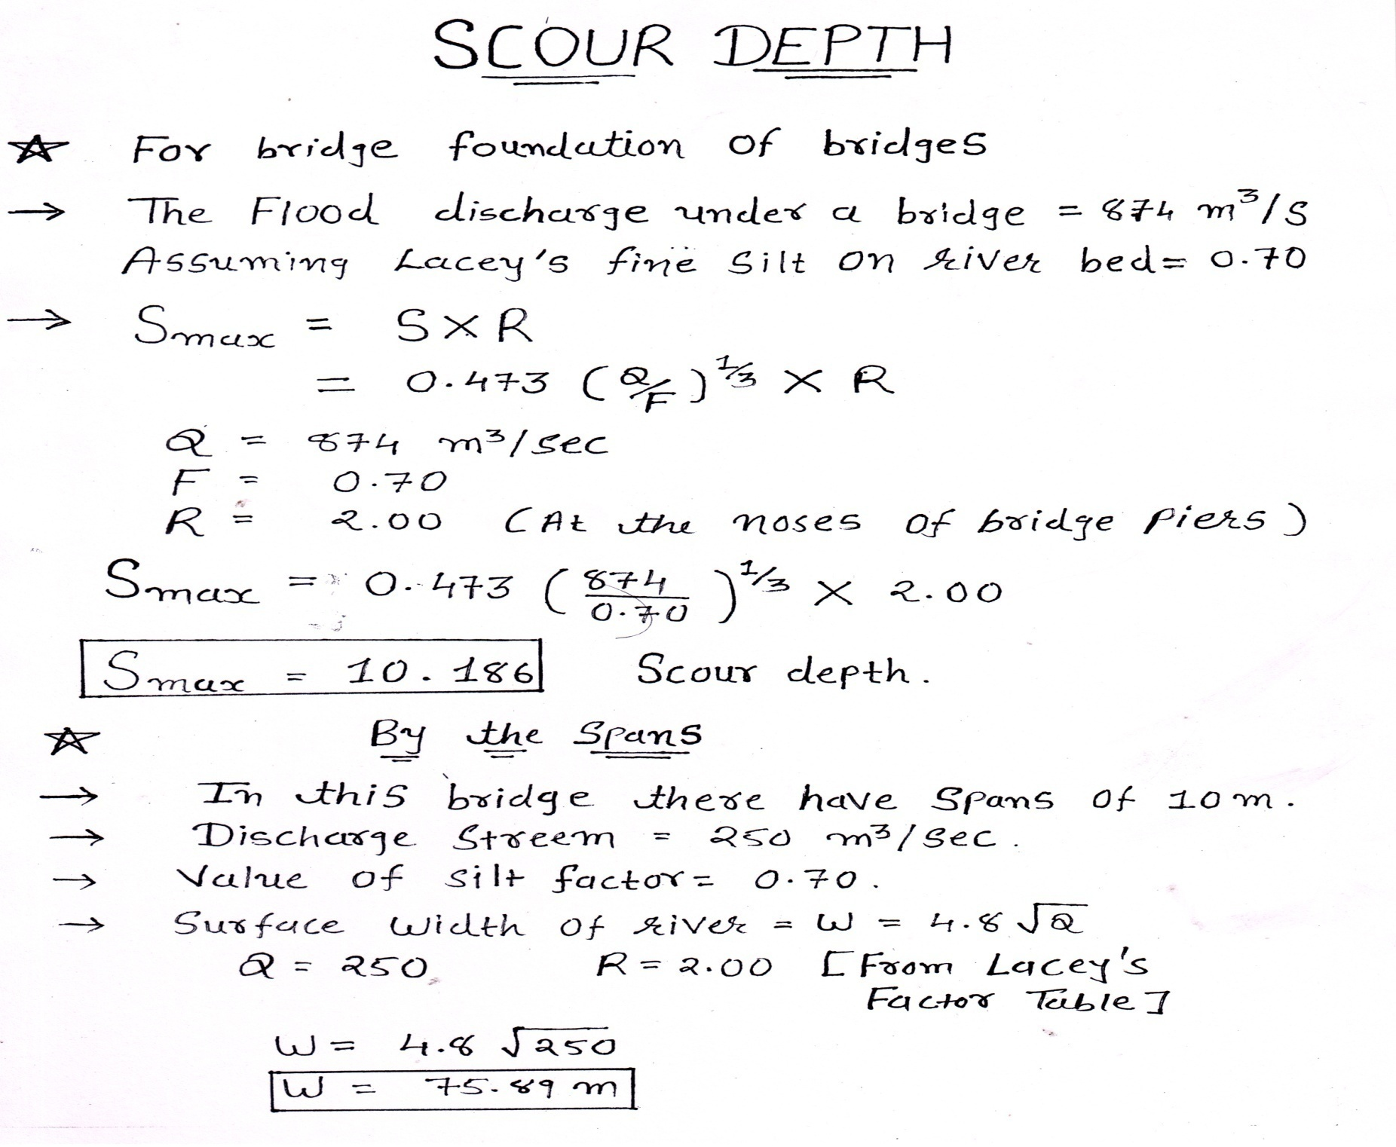

Slide 31
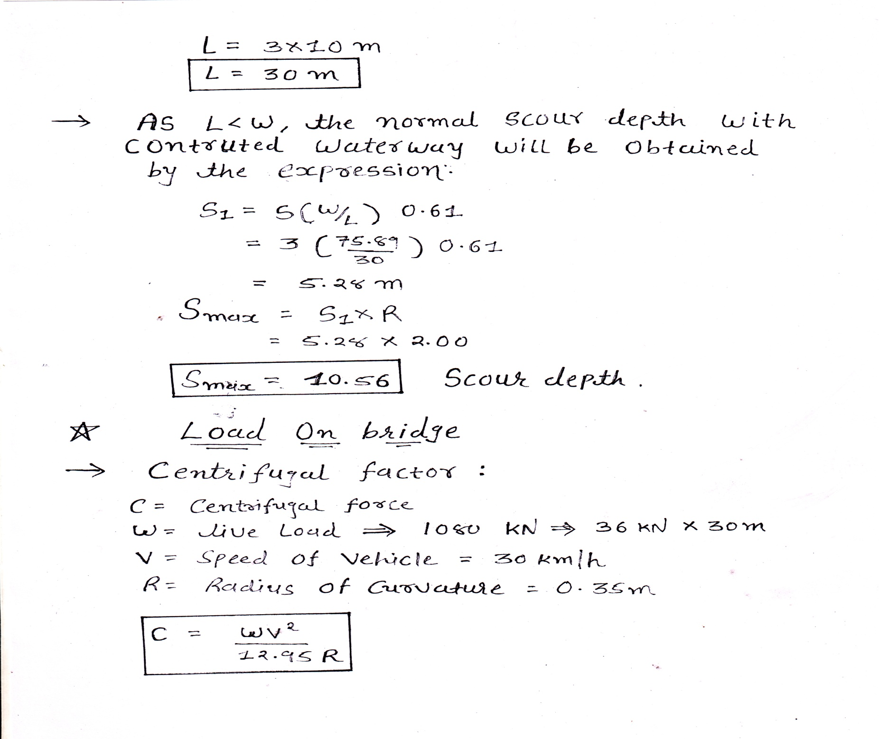

Slide 32
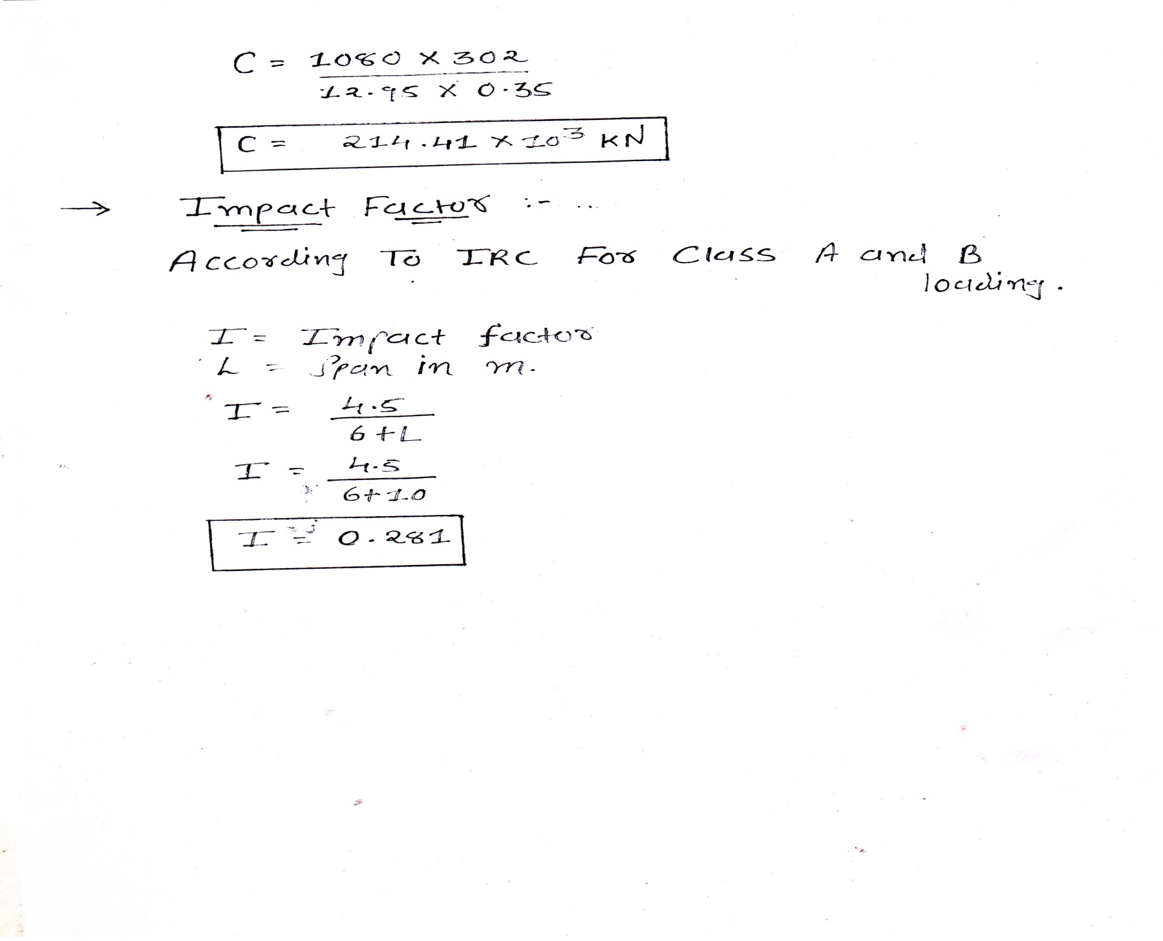

Slide 33
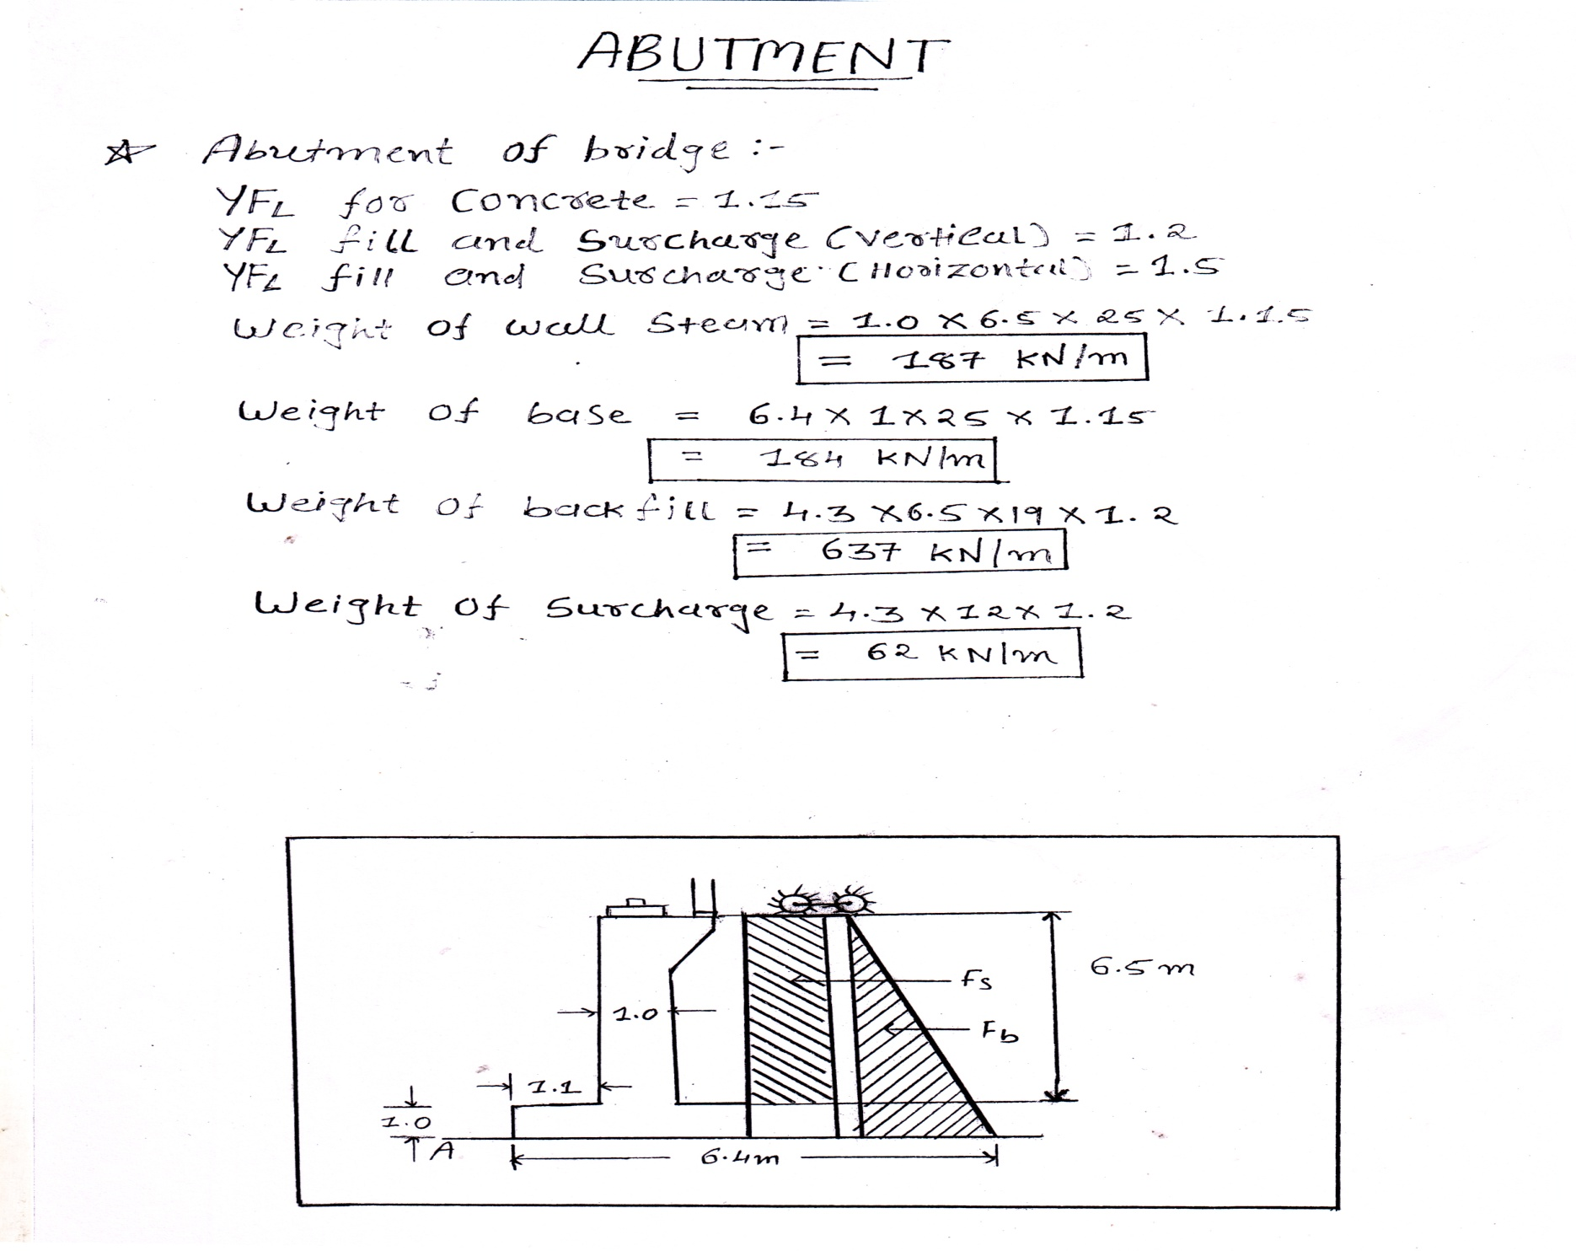

Slide 34
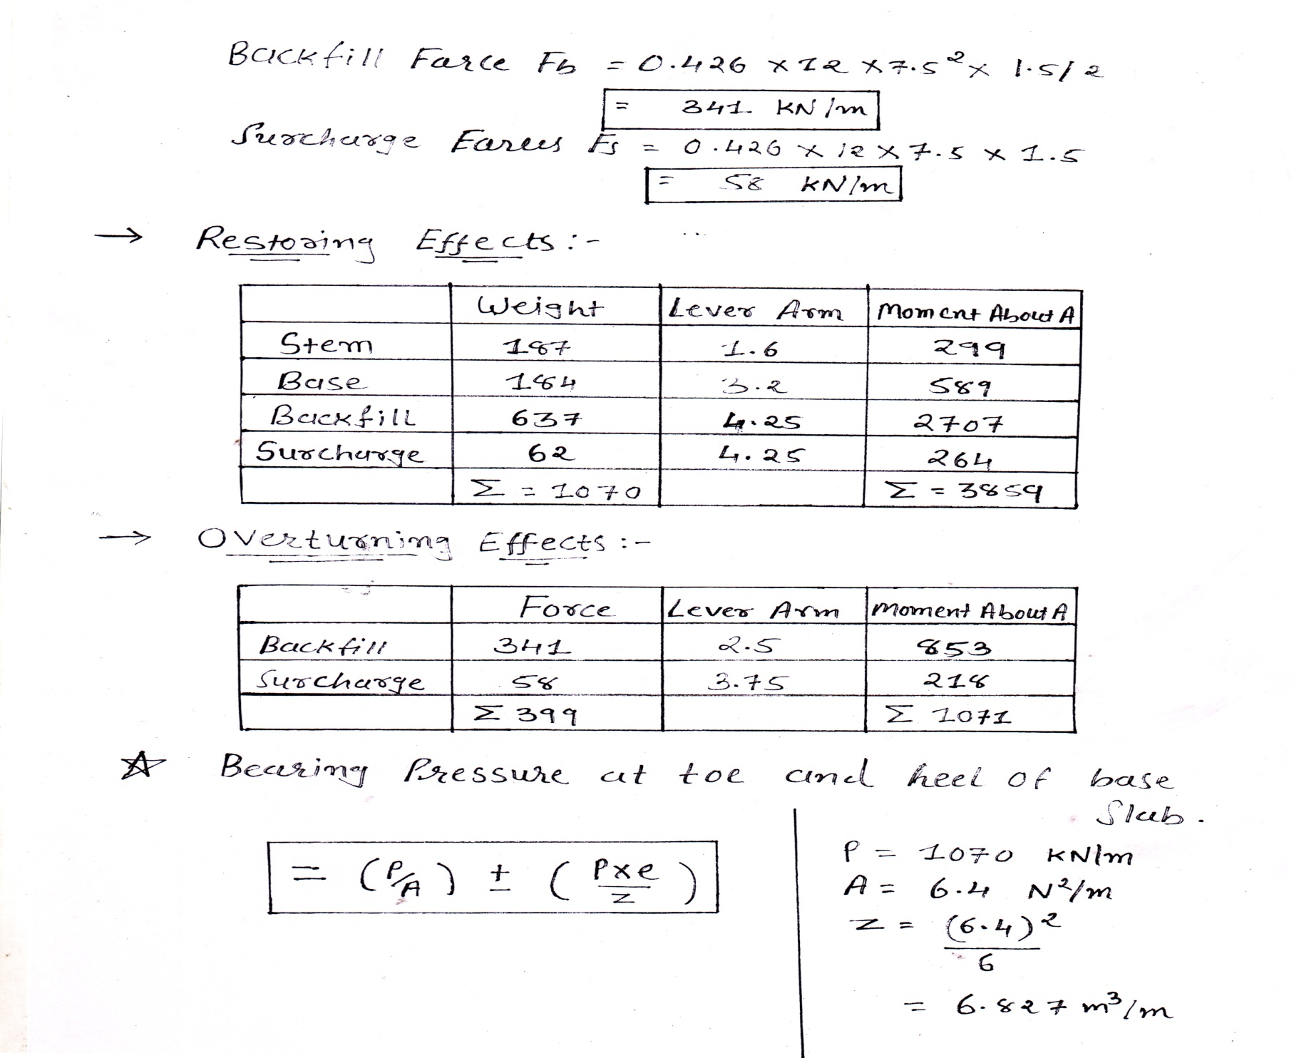

Slide 35
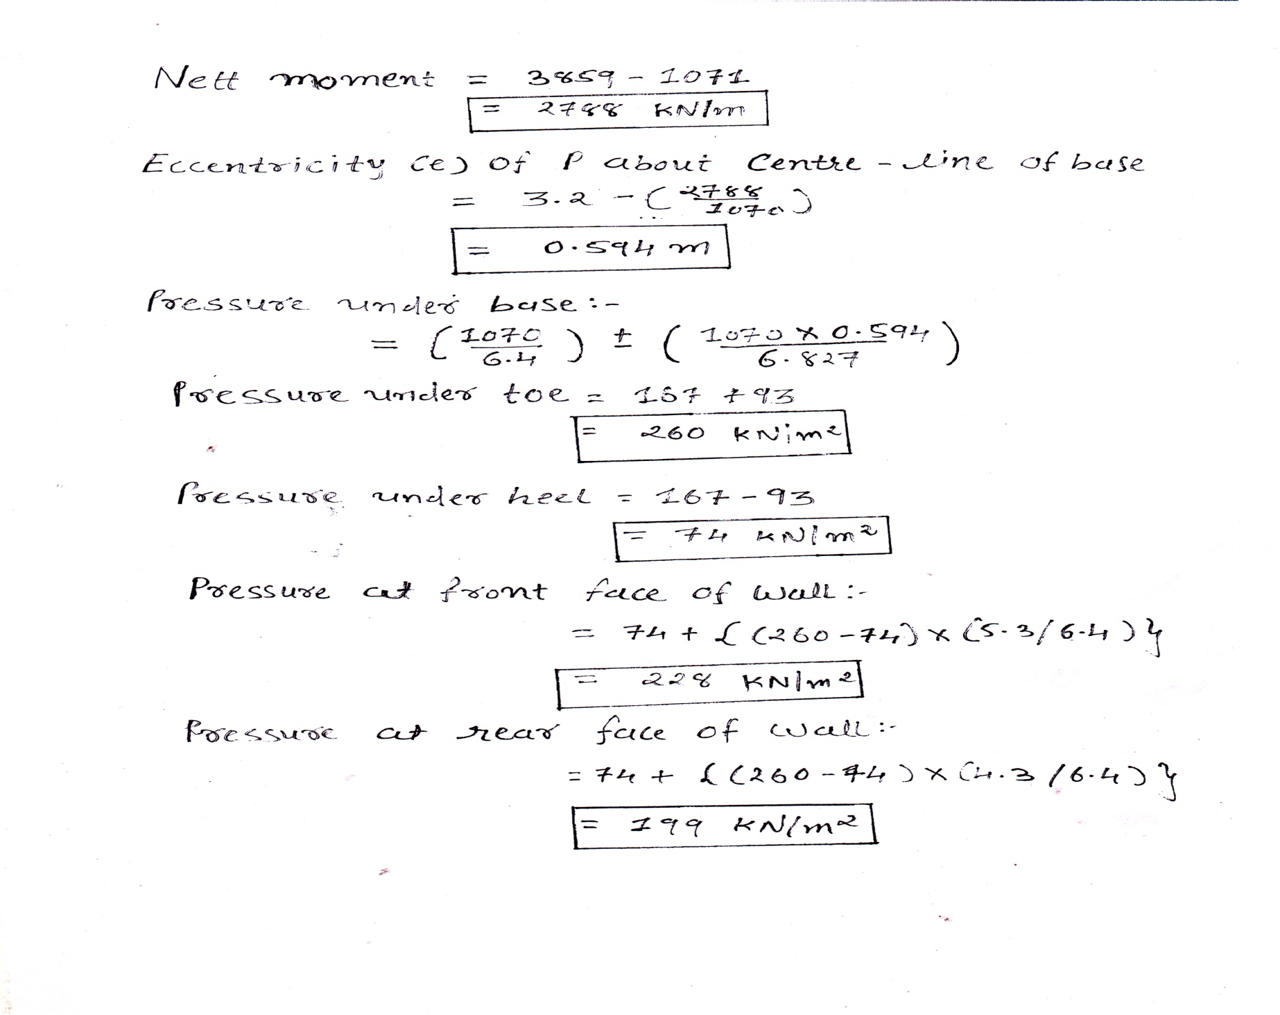

Slide 36
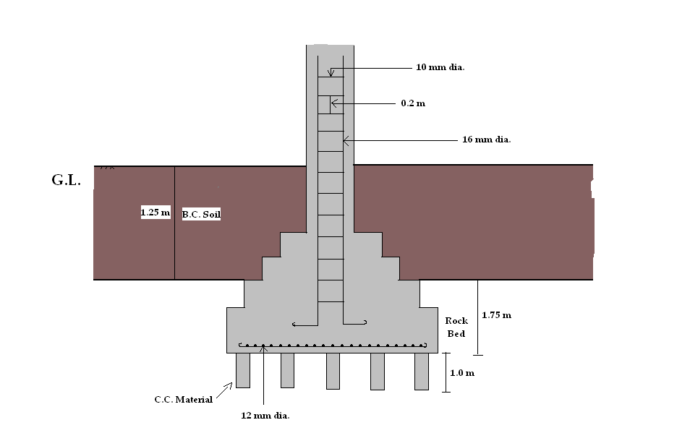

Slide 37
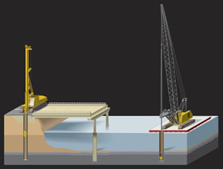
Precautions have to be taken when making the structure on soft soil :
1) Use the deep foundation for structure like pile foundation.

Slide 38
Pile Design:
Most Common
Steel Pipe Piles (open or closed end)
H-Piles
Less Common
Prestressed Concrete
Timber
Bearing Resistance (compression and tension)
Lateral Resistance
Settlement and Downdrag Analysis
Corrosion Potential/Protection
Tip Protection
Pile Drivability (construction)
Group Settlement, Group Effects

Slide 39
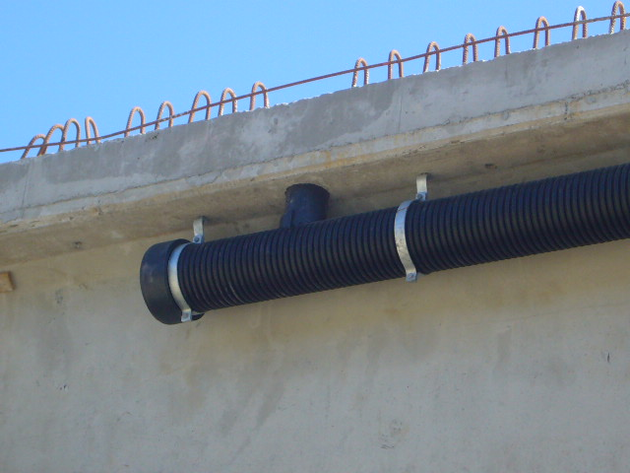
2) Providing suitable drainage system for bridge.

Slide 40
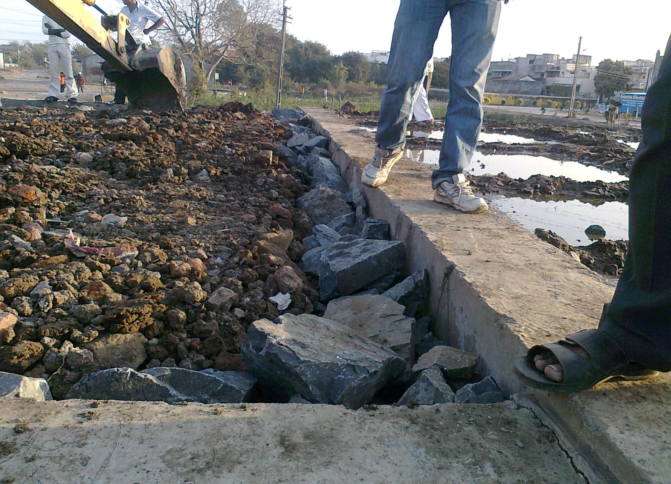
3) Make the filter media of rubble for side of abutment of bridge.

Slide 41
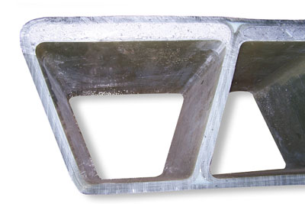
4) Design the lightweight superstructure of bridge.
Because if weight of superstructure is low then load comes on foundation is less.
Superstructure

Slide 42
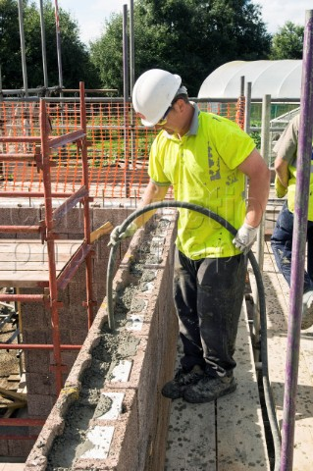
Points to consider in mind while doing the foundation on Black cotton soil / clay soil.
1) Always give soil treatment to subgrade before
placement of concrete.
2) Always apply vibrating equipment after
placement of concrete.

Slide 43
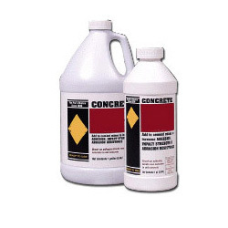
3) Mix suitable
admixture in
concrete . Admixture
Give more strength
to concrete & reduces
cement level i.e low
consumption of cement
which reduces the cost of
constrution.

Slide 44
Conclusions
The project is limited to the design of foundation,pier and abutment considering in the black cotton soil. which have very dangerous behavior and as such we have taken depth of foundation as depth from H.F.L to the depth of foundation we have taken the remedial measure to project to the foundation against sliding ,overturning so that it’s should be stable . we have made study of failure of bridges all around the world. precautions measure they have suggested that is also taken in consideration. It is a live project Constructed at parab haldaru kamrej , surat. No doubt they have considered same is suggested in this project . So the bridge will be a stable.

Slide 45
REFERENCES
Concrete Bridge Practical.
Bridge Engineering (Rangwala’s Book)
Site of Akshay Construction,Surat
www.wikipedia.com
www.Google.com
Guided by :
MR. V.P.LUNJA ( PRINCIPAL)
MR. R.D.PATEL ( LECTURER)
MR. S.P.PATEL ( SITE ENGINEER)

Slide 46

Thank you

